Slide 1

BETA
DataScience
Notes:
Introduce Trainers, and have Participants introduce themselves

Slide 2

20 Thousand Students Annually
43% Girls and Young Women
46% African-American or Latino

Slide 3
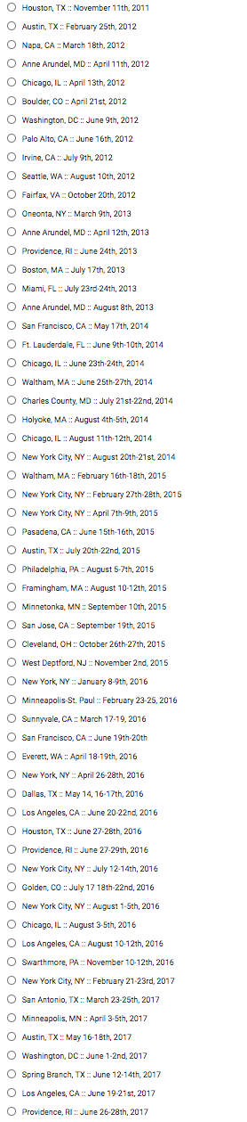
2011
2017

Slide 4
Goals for this Workshop
Understand what “Data Science” is, any it matters
Get comfortable with programming in Pyret
Work through the entire curriculum
Discuss pedagogy
Get your feedback

Slide 5
What does “Beta” mean?
It’s not finished!
There are going to be some bugs!
We don’t have all the answers
You will help set the direction for Bootstrap:DataScience

Slide 6
Agenda
What is Data Science?
Overview
Practice
Feedback

Slide 7
What is Data Science?
Notes:
Equity implications of these points

Slide 8
Challenges for K12
Professional DS tools aren’t student-friendly
Non-DS languages are cumbersome
Importing data
Batteries not included (plotting, stats)
Loops take time!
Off-the-shelf means teachers spend time putting the pieces together.
Notes:
Equity implications of these points

Slide 9
Bootstrap’s Solution
Build a DS tool made for learning!
Easy importing from Google Sheets
Make tables as easy as numbers
If tables are values, queries are expressions
No loops!
Curated datasets, curriculum and pedagogy
Notes:
Equity implications of these points

Slide 10
Agenda
Theory
Overview
Practice
Pedagogy

Slide 11
Bootstrap Materials
Software: In the cloud, or on your machine.
Lesson Plans: Detailed[*] curricula, student handouts, integrated workbooks, and supplemental activities.
Standards: All lessons are aligned to National and State Standards.
Language: Algebraic semantics, integrated tables, integrated graphing and plotting

Slide 12
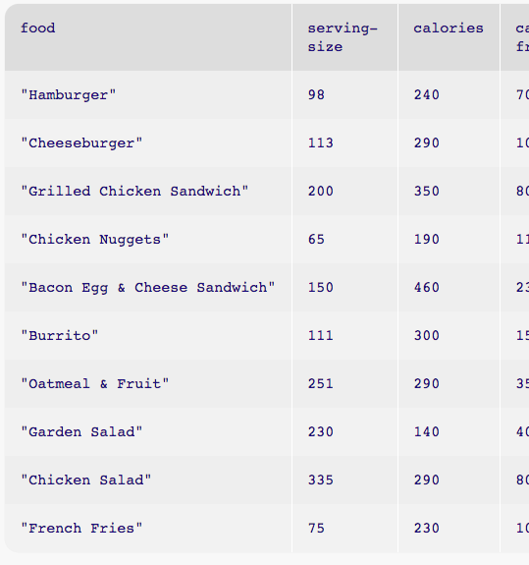
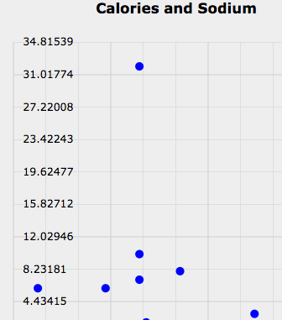
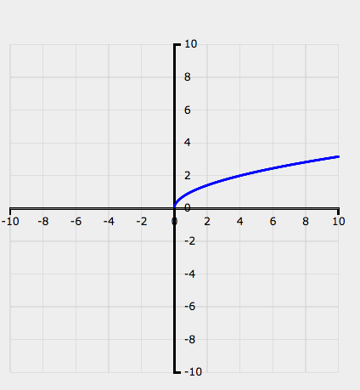
10,000 Foot View
Introduction to programming and plotting in Pyret
Introduction to tables in Pyret

Slide 13
10,000 Foot View
Introduction to programming and plotting in Pyret
Introduction to tables in Pyret
Measures of Center
Bar and Pie Charts

Slide 14
10,000 Foot View
Introduction to programming and plotting in Pyret
Introduction to tables in Pyret
Measures of Center
Bar and Pie Charts
Histograms
Notes:
How do we know the kids are actually getting this?
We do something that most colleges don’t do: code reviews.

Slide 15
10,000 Foot View
Introduction to programming and plotting in Pyret
Introduction to tables in Pyret
Measures of Center
Bar and Pie Charts
Histograms
Line of Best Fit

Slide 16
10,000 Foot View
Introduction to programming and plotting in Pyret
Introduction to tables in Pyret
Measures of Center
Bar and Pie Charts
Histograms
Line of Best Fit
Selecting and Sorting Tables
Filtering rows with Boolean Expressions
Computing new columns

Slide 17
Where does DataScience fit?
Data Science Classes
Math & Statistics Classes
Business Classes
Civics Classes
AP CS Principles Classes

Slide 18
Agenda
Introduction
Theory
Practice
Pedagogy

Slide 19
Setting up your classroom
Physical Materials (workbooks, pens, etc)
One computer for each pair of students
Gmail Account (per-class? per-pair?)
Log into http://code.pyret.org/ (IE9+, FF, Chrome)
Go to www.BootstrapWorld.org/materials

Slide 20
Unit 1

Slide 21
Questions that Matter
Find a topic that interests you (max 4 students to a topic!)
Choose a question, or create your own
Discuss your answer to the question (2min)
What measurements did you use to get that answer? (2min)

Slide 22
Unit 2

Slide 23
Error Messages
How we react is key: are we scared or excited?
“The computer is giving you a clue…”
“What do you think it’s trying to tell us…?”

Slide 24
Driver / Navigator
Pair programming needs structure!
The “Driver” has their eyes on the computer
The “Navigator” has their eyes on the workbook
Switch roles regularly

Slide 25
10min Break!

Slide 26
Unit 3

Slide 27
Unit 4

Slide 28
Unit 5

Slide 29
Unit 6

Slide 30
10min Break!

Slide 31
Unit 7

Slide 32
The last lessons…

Slide 33
Implementation

Slide 34
Next Steps
You’ll need access to a computer lab
You’ll need Google accounts
Join our Google Group for questions and answers
Figure out your integration plan

Slide 35
Sample Questions for Breakout
What elements are usable without a computer?
What elements would you like to integrate?
What will be the challenges for using Bootstrap?
Create a rough calendar for when you might use each section of Bootstrap.
Report back after the breakout!

Slide 36

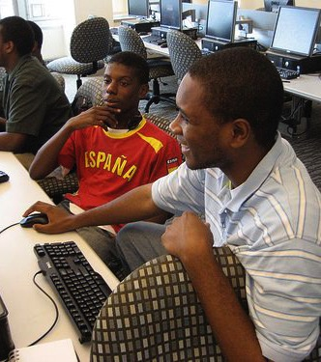
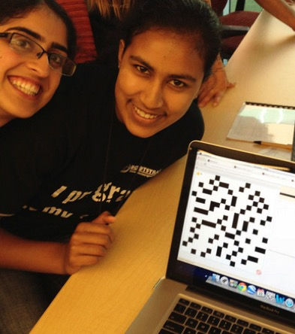
Algebra
Bootstrap:Algebra applies algebraic
concepts and rigorous programming
principles to creating a simple
videogame. Students use order of
operations, function composition, the
distance formula, coordinates and inequalities in the plane to detect collisions, handle keystrokes, and determine how they move and interact – with each challenge framed as a standard word-problem. The module is aligned to National & State Standards for Mathematics, the CSTA standards and K12CS frameworks, and has been shown to improve students’ performance on standards algebraic tasks*.
DataScience
Which artist do you listen to most? Do
schools in richer areas of your town do
better than those in poorer ones? What’s
the healthiest cuisine? Our Data Science
module teaches students to view
programs as questions we ask of data. Students form their own questions about the world around them, and learn to analyze data critically and carefully to find answers. Business, science, and history teachers can utilize this module to help students make inferences from data. Math teachers can use this module to introduce statistics in an accessible way. It also works great as a module for AP CS Principles’ unit on data!
Physics
This module is developed in partnership
with the American Association of Physics
Teachers & American Modeling Teachers
Association. It helps students understand
dynamics concepts by using
programming to build models of the
physical world. The module is targeted at ninth grade, a year in which every student is expected to take science. The module is aligned to the Physics First movement, allowing teachers to present computational modeling as a basic tool to students preparing to study science more broadly.
Reactive
Bootstrap:Reactive goes deeper into
programming, building events and data
structures on top of the foundation laid by
our intro courses and allowing students to
build far more sophisticated programs.
Students learn how the event loop that drives their Bootstrap:Algebra game works, and use it to create animations using simple datatypes. They then learn about data structures, and design a structure for a sophisticated game of their own design. Bootstrap:Reactive is aligned to the CSTA standards and K12CS frameworks.
Notes:
This is just one part of a multi-facet pathway that we at Bootstrap have created. Bootstrap:Physics allows your physics teacher to integrate computing into a standard HS Physics class, and Bootstrap:Reactive allows your students to go deeper into CS by building on – rather than throwing away – what they’ve learned. But there’s also a new trend in CS, which is taking over universities and the corporate world: Data Science. Here are just a few screenshots of major institutions that are pushing for Data Science. And now…Bootstrap is offering an introductory Data Science module for middle or high school, which requires no computing background!

Slide 37


Connect with Us!
/ BootstrapWorld
@BootstrapWorld
Questions:
bit.ly/BootstrapHelp
Grab a photo!

Slide 38
We’d like your feedback!

